Slide 1
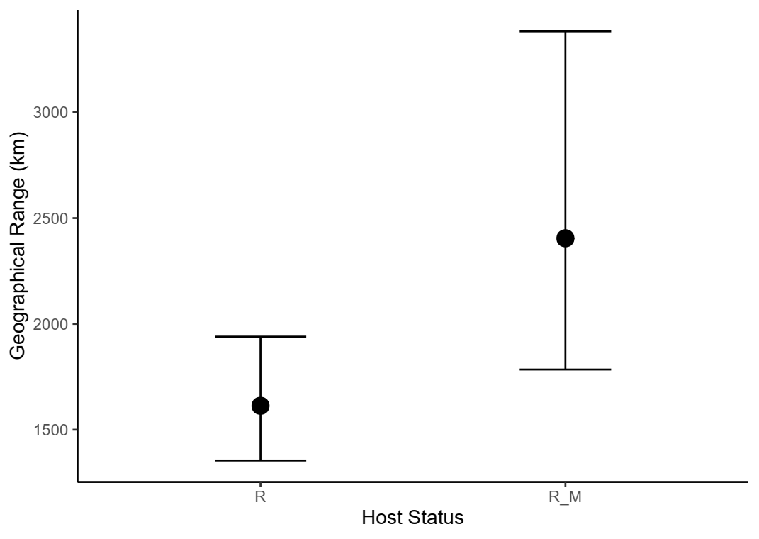
N= 46
N= 129
Resident
Resident and any migrant

Slide 2
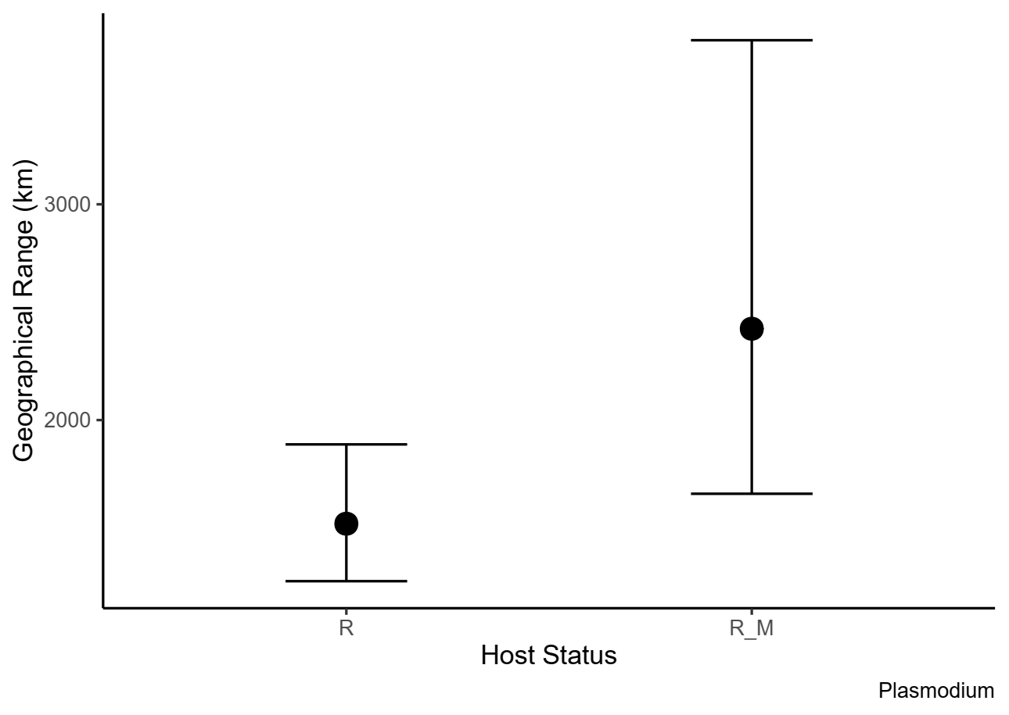
N= 25
N= 93
Resident
Resident and any migrant

Slide 3
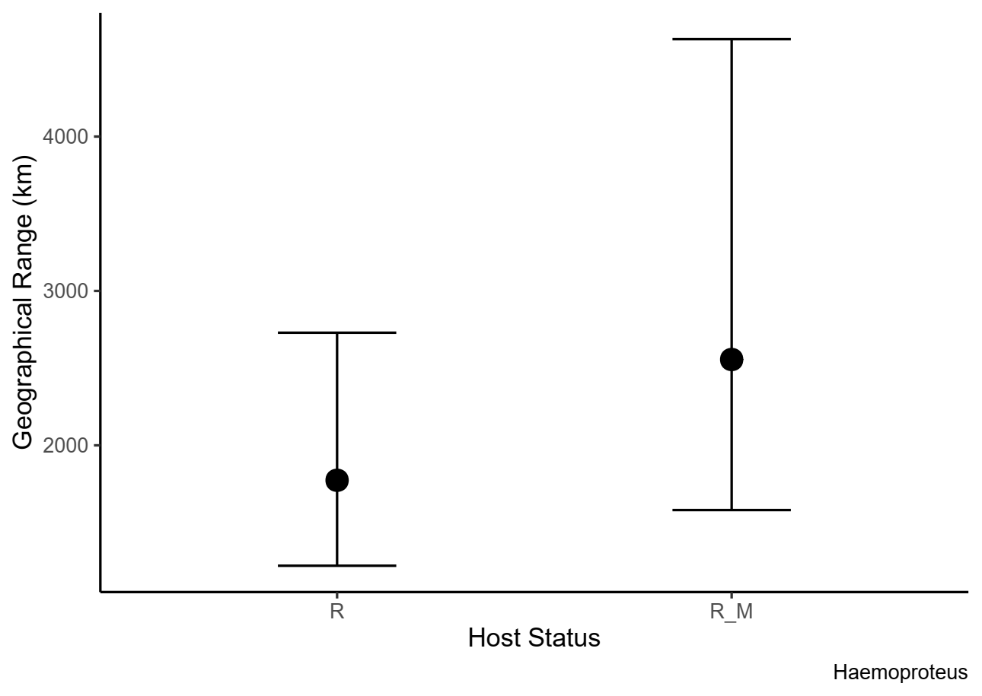
N= 21
N= 36
Resident
Resident and any migrant

